Slide 1
UNIT 2 : CRITICAL THINKING IN GAME DESIGN
Subtitle

Slide 2
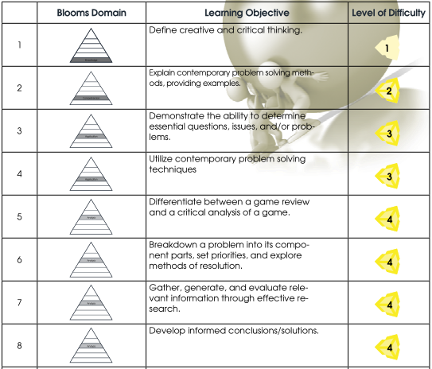
LEARNING OBJECTIVES
By the end of this unit, learners should be able to perform the following tasks:

Slide 3
1. Introduction to creative and critical thinking practices
a. What does it mean to think critically? Think creatively?
b. Critical thinking terms: ambiguity, assumptions, values, emotions,
argument, fallacy, thinking barriers, language, etc.
c. Tools for critical thinking (e.g. SWOT analysis)
d. Critical thinking and the evaluation process
Notes:
think critical
question the problem
gather information
evaluate the solution
think creatively
plan a solution
create the solution
present the solution

Slide 4
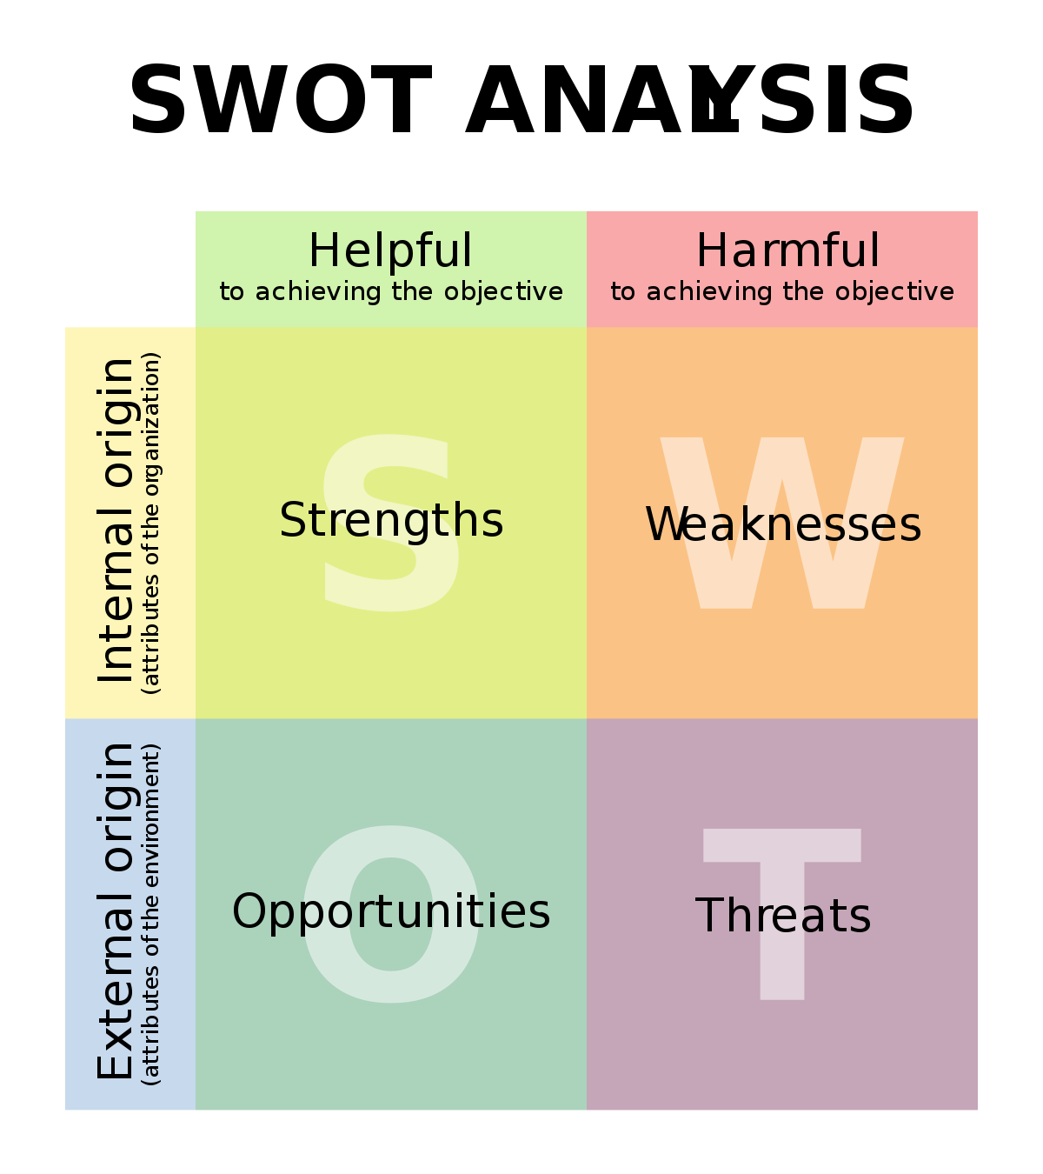
Notes:
Key Points
SWOT Analysis is a simple but useful framework for analyzing your organization's strengths and weaknesses, and the opportunities and threats that you face. It helps you focus on your strengths, minimize threats, and take the greatest possible advantage of opportunities available to you.
It can be used to "kick off" strategy formulation, or in a more sophisticated way as a serious strategy tool. You can also use it to get an understanding of your competitors, which can give you the insights you need to craft a coherent and successful competitive position.
When carrying out your analysis, be realistic and rigorous. Apply it at the right level, and supplement it with other option-generation tools where appropriate.
Strengths: characteristics of the business or project that give it an advantage over others
Weaknesses: characteristics of the business that place the business or project at a disadvantage relative to others
Opportunities: elements in the environment that the business or project could exploit to its advantage
Threats: elements in the environment that could cause trouble for the business or project

Slide 5
2. Idea Generation
a. Introduction to brainstorming and mind mapping
b. Idea sorting
i. Immediate usefulness
ii. Areas for exploration
iii. New approaches to problem solving
Notes:
Brainstorming is a technique for recalling what you know about a topic. Mind mapping can then be used to work out the relationship between those points and ideas. When you set down your ideas visually in this way, you can make connections and develop greater understanding of information. It is a good way to begin planning for an assignment, essay, research topic or oral presentation.

Slide 6
3. Phases of decision making/problem solving
a. Problem identification
b. Information gathering
c. Brainstorm solutions
d. Compare the pros and cons of each option
e. Test selected solution
f. Evaluate the effectiveness of the solution

Slide 7
Self-Pace Learning Activities

Slide 8
Exploring the Unity Editor
At this point, learners have opened the Unity Editor and should be familiar with the user interface. This unit will allow them to experiment with importing and manipulating game objects.
Learners can complete the following brief tutorial on game objects in the Unity Editor:
http://unity3d.com/learn/tutorials/modules/beginner/live-training-archive/gameobjects
Learners can reference the Unity Manual for additional background on game objects.
http://docs.unity3d.com/Manual/TheGameObject-ComponentRelationship.html

Slide 9
Game Developers Journal
Within your Game Developers Journal, use mind-mapping techniques to illustrate your top two or three ideas (from the five ideas generated during Unit 1). At this point, you should focus on producing a high level mind-map,illustrating only a few levels deep. You will continue to refine your decision and add detail to your map as the learning progresses.

Slide 10
Contemporary Game Assignment -1
Select one of the games found at: https://unity3d.com/showcase/gallery/games
Play on your own, if the mechanics allow it. If the game only supports multiplayer modes, play with one or more of your peers. Play as a designer, paying attention to the mechanics, dynamics, and aesthetics as described in the Mechanics-Dynamics-Aesthetics (MDA) framework. If you are unfamiliar with the MDA framework, search for it online and familiarize yourself with it prior to performing this step.

Slide 11
Contemporary Game Assignment -2
Reflect on your play experience.
• What were the game’s apparent design goals? Did it succeed at those goals? Why or why not?
• What were the mechanics? What was the play experience? What is the relationship between the two? Did you find any strategies that were exploitable? Did the game seem well-balanced?
• What kinds of interesting decisions (and uninteresting ones) were you making throughout the game? What do you feel was the competitive differential of the game?

Slide 12
Contemporary Game Assignment -3
Write your analysis of the game within a new Game Modification Task Sheet. Include the following information:
Name of the game and its publisher (this will help get you in the habit of giving credit where due. It will also ensure everyone references the same game).
Describe the core mechanics of the game. You do not have to reproduce the rules, but you should describe the basic play of the game and the main decisions players are making. Assume your audience has never played the game before!
Include the Mechanics-Dynamics-Aesthetics (MDA) of the game, showing how they emerge from the mechanics (if you are not sure, provide a guess).
State the game’s design goals. Indicate what the designer was trying to do! Then, indicate whether you feel the game met those goals, explaining why or why not.

Slide 13
Contemporary Game Assignment -4
Note anything else you can about the game (such as a particular issue with game balance or a unique use of game components).
Lastly, if you were the designer, what would you change about the game (if anything)? Make specific recommendations for your suggested changes. For example, do not just say “I would make the game more interactive between players” or “I would fix the problem that I identified earlier” — say how you would fix things. What rules would change and what would they change to? Would you change any game objects or values?
Remember, your audience is made up of other game designers. Write your analysis so that other designers can learn from the mistakes and successes of the game you chose. Your goal is to educate and inform them about the game you selected. Another goal is to discover new lessons about what makes games work or not work. These goals are more important than a review score!

Slide 14
Critical Thinking Assignment
Do you agree or disagree with the following statement? Explain your response.
“Not only do we tend to think about the world according to what we want to see and what we need to see, we tend to think in terms of what we expect to see.”

Slide 15
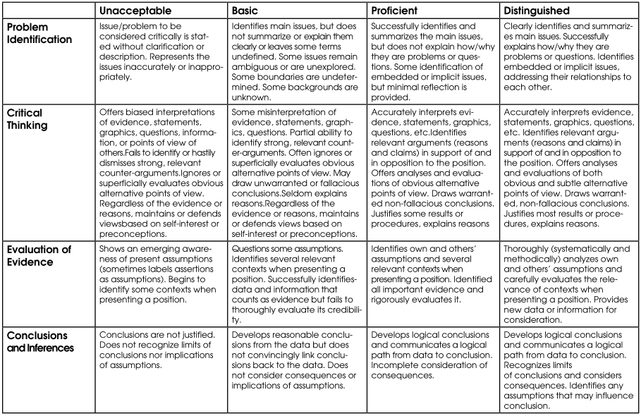
ASSESSMENT REFERENCE GUIDE
Critical Analysis Assignment – Assessment Rubric

Slide 16
SUGGESTED RESOURCES
Which books, digital resources, & other materials will be used in this lesson? Listed below is a recommendation of resources to consider for this unit:
1. Game analysis Guidelines: http://ocw.mit.edu/courses/comparative-media-studies/cms-300-introduction-to-videogame-studies-fall-2011/assignments/game-analysis/MITCMS_300F11_GameAnaGuide.pdf
2. http://www.criticalthinking.org/ctmodel/logic-model1.htm: Useful to help learners understand and perform critical thinking.
3. Critical Thinking PowerPoint: http://www.slideshare.net/balibarbara/critical-thinking-powerpoint-17741703
4. The Six-Step Problem-Solving Process: http://www.aleanjourney.com/2012/05/six-step-problem-solving-process.html
5. Unity Online Manual Document: http://docs.unity3d.com/Manual/TheGameObject-ComponentRelationship.html
6. Unity Online Tutorial Video: http://unity3d.com/learn/tutorials/modules/beginner/live-training-archive/gameobjects

